Slide 1

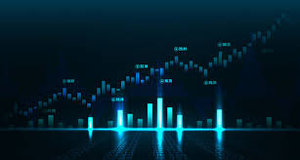
A Winning Strategy “If you want to have a better performance than the crowd, you must do things differently from the crowd” - Sir Johnson Templeton
Jeremy Radcliffe, Levi Christian, Bill Udeh

Slide 2
Stock Trading Algo Overview
Utilizing industry standard leading and lagging indicators as feature inputs to our model, we sought to assess their impact on returns.
Our system evaluated _______ months of historical data consisting of daily close prices of ____ top stocks from each industry.
Allocating an initial investment of $10,000 over a 6-month holding period, our model endeavored to predict next days price and produce positive returns?

Slide 3
Trading Model Summary
Model Check
Neural Network model utilizing stocks and four (4) features: Bollinger Bands, MACD, RSI and EMA benchmarked against the S&P500.
Target
Utilized Positive Returns as the Target to determine the success of our model. Long positions represented as “1”, Short positions represented as “-1” and “0” represented as neutral
Results
While the model accuracy score is low, results from cumulative returns were favorable

Slide 4
Historical Precedence

Slide 5
Core Questions
Can we iteratively improve the model accuracy by analyzing additional Time Series data and/or utilizing NLP to include additional features based on fundamental analysis?
TBD

Slide 6
Data Sources and Python Packages
Alpaca sourced Daily Close Price Data for:
S&P500
FB
Python Packages:
Pathlib
Pandas
Numpy
Joblib
Tensor Flow

Slide 7
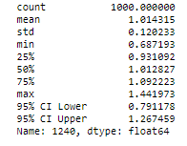
Data Analysis
TBD
TBD

Slide 11
Observations
We discovered that although the accuracy score was slightly above 50%, the overall performance over the targeted time period out-performed our SP&500 benchmark by more than 5% in most cases and as much as 20% in other cases.
Absent analysis of individual features made it difficult to determine which had the highest impact on returns thus a classification report would need to be produced in order to perform this level of analysis.
While the model performs well over a 6mo period, testing over longer periods produced…….

Slide 12
Postmortem
TBD.

Slide 13

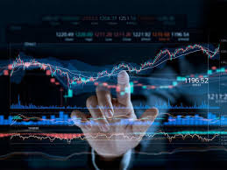
Questions?

